Slide 1
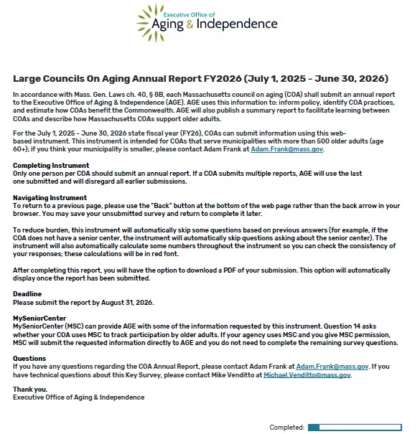

Page 1 – Introduction/
Navigating the Survey
Report is required by statute.
Due August 14, 2026.
https://app.keysurvey.com/f/41843794/a502/ to complete the survey.
https://coaadmin.mass-aging-disability.org/ for a non-fillable PDF of the online survey.
Write to adam.frank@mass.gov with questions.

Slide 2
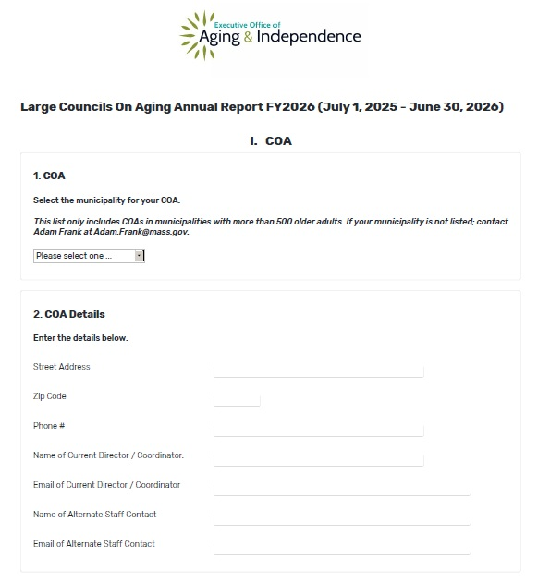
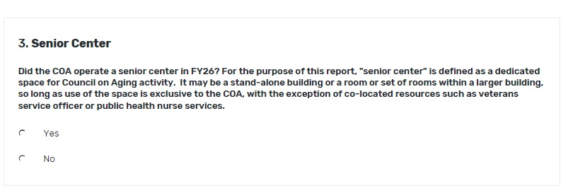
Page 2 – Senior Center Info
Include e-mail if you want to receive confirmation when complete.
Question 3 – Select “yes” if your COA has a dedicated space for programs and activities.

Slide 3
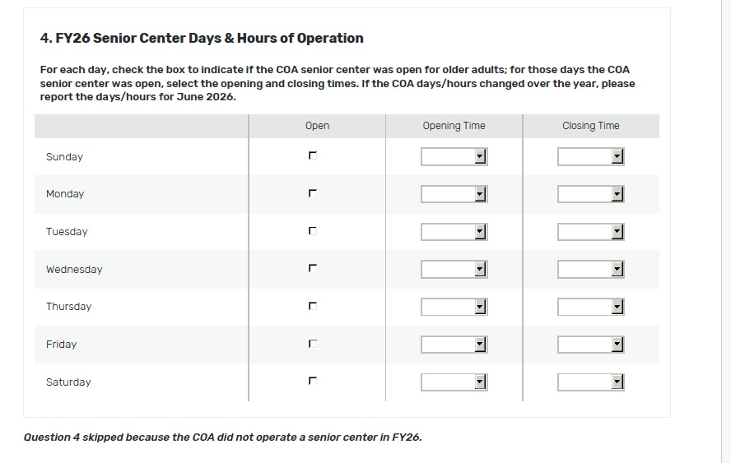
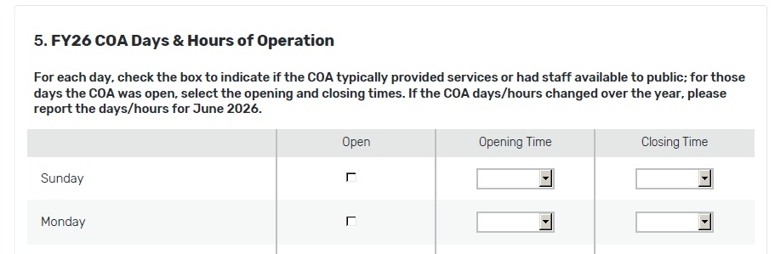
Page 2 – continued. Hours of Operation.
Survey uses skip logic to send you to Question 4 if you operate a senior center, and Question 5 if you do not.
If hours vary, please select hours for a “typical” week.
If you do not operate a senior center, select hours in which activities are offered or staff are available to the public.

Slide 4
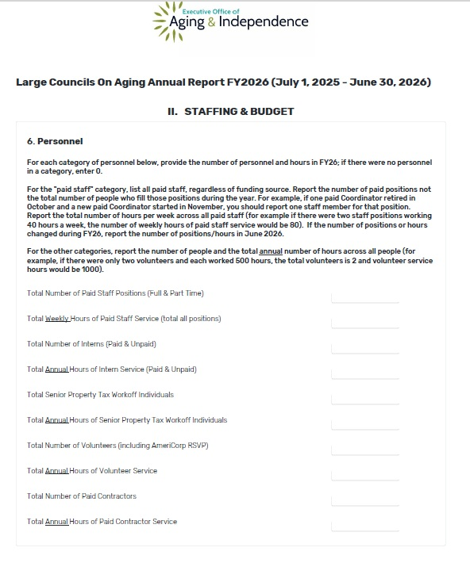
Page 3 – Personnel
Include all staff, regardless of funding source.
Count number of positions, not number of people.
Count weekly hours for paid positions.

Slide 5
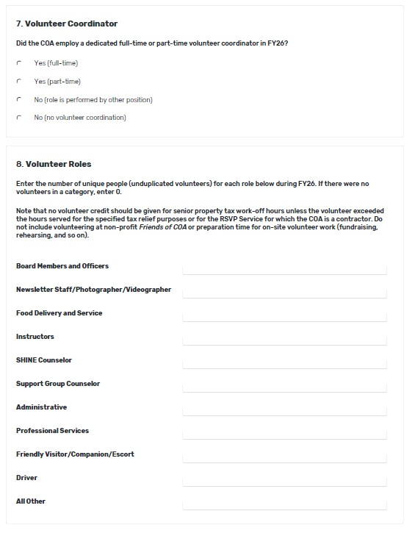
Page 3 continued – Volunteers
For volunteers, please count annual hours.
Count only tax workoff and RSVP volunteers that work at COA.
If a volunteer serves in more than one role, count multiple times.

Slide 6
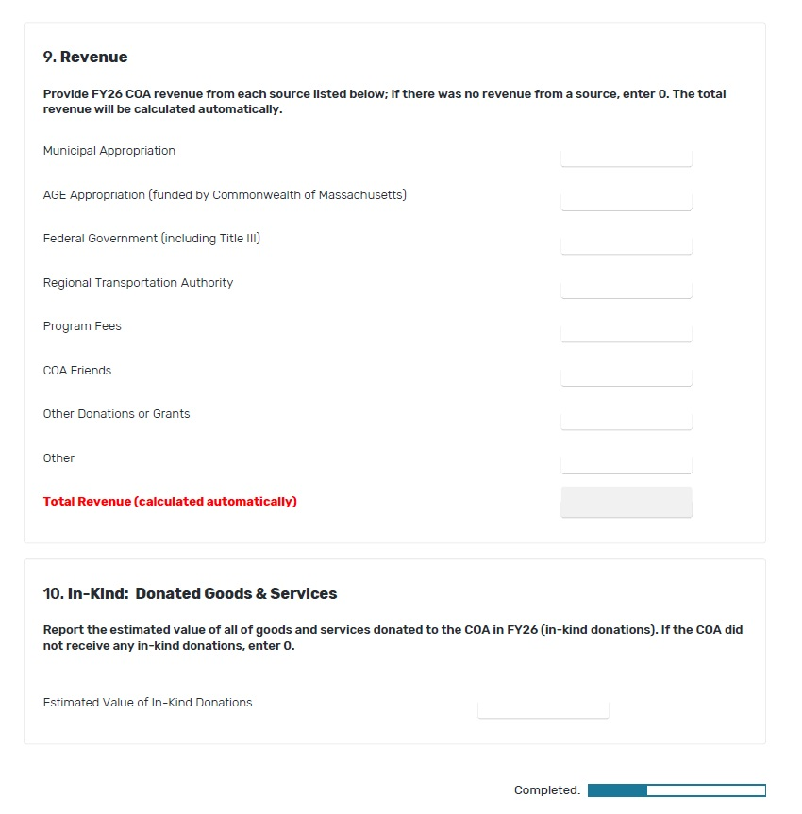
Page 3 continued – Revenue
“AGE Appropriation” is formula grant.
In-kind donation is anything that is not cash.
For in-kind services, you can use $42/hr or go to https://data.bls.gov/oes/#/area/2500000/2025 for specific job categories.

Slide 7
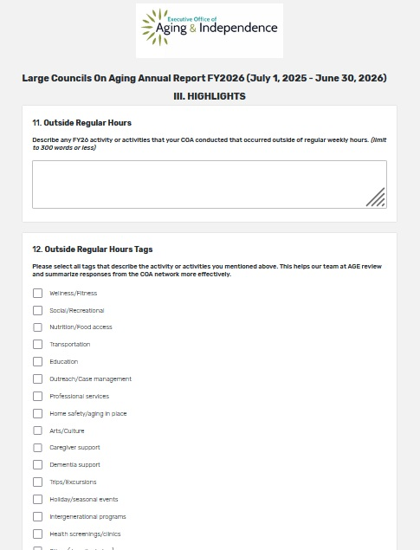
Page 4 - Highlights
Optional.
Open ended questions.
Informs narrative section of AGE annual report.
Offers a chance to include categories not included under activities.
May inform a searchable database for COAs in the future.

Slide 8
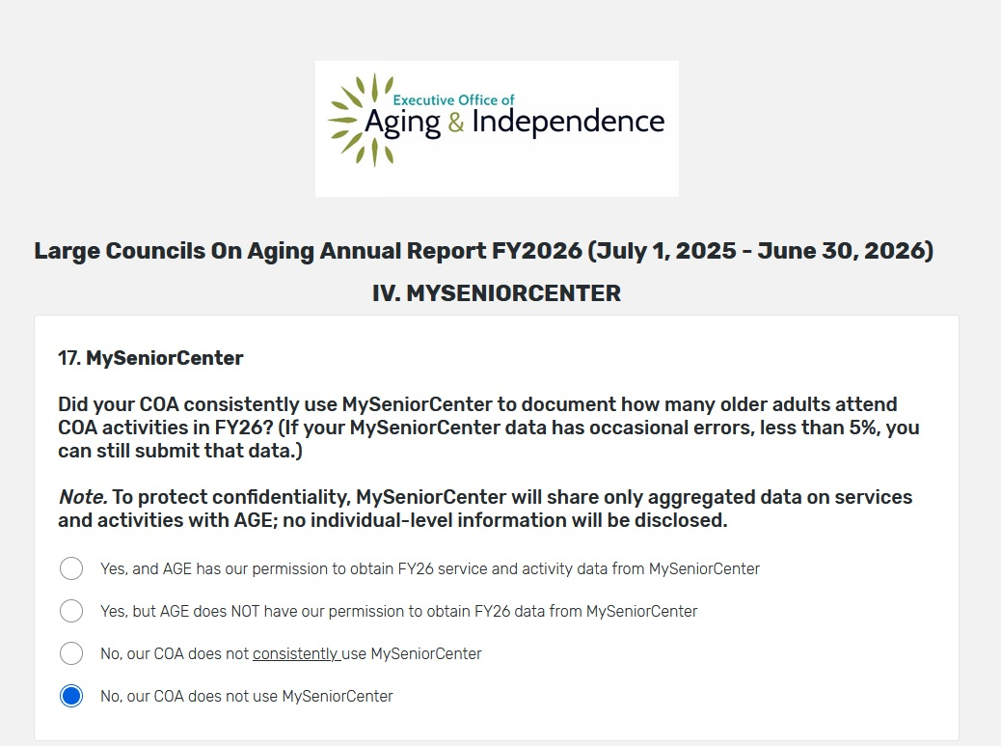
Page 5 - MySeniorCenter
Choose Option 1 if you want to complete report by sharing MSC activity and demographic information with AGE.
No personal or private information will be shared.

Slide 9
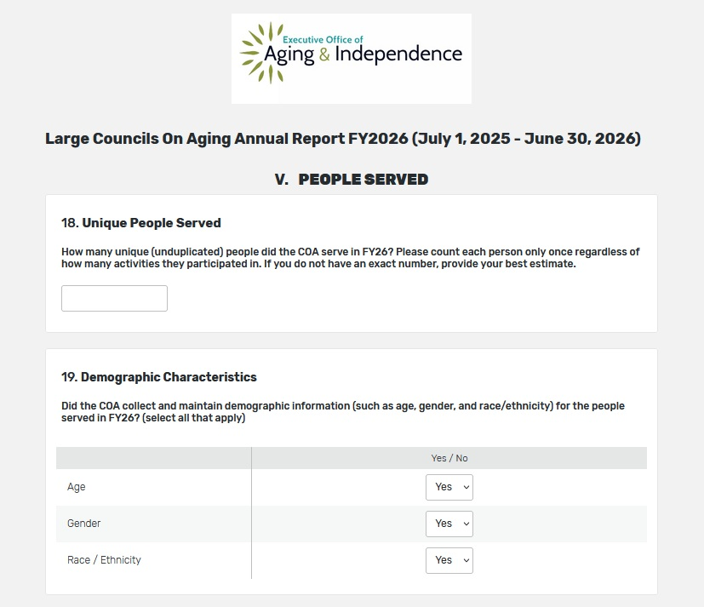
Page 6 – People Served
Helps AGE inform policy on outreach and diversity.
Survey will skip over categories for which you select “No.”

Slide 10
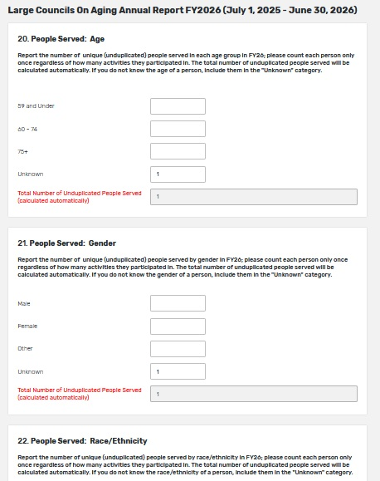
Page 7 – Age, Gender, Race/Ethnicity
Ethnicity categories correspond to U.S. census.
Use “other category” for cases where participant does not identify with any of the listed categories.
Use unknown for participants for whom this data is not tracked.

Slide 11
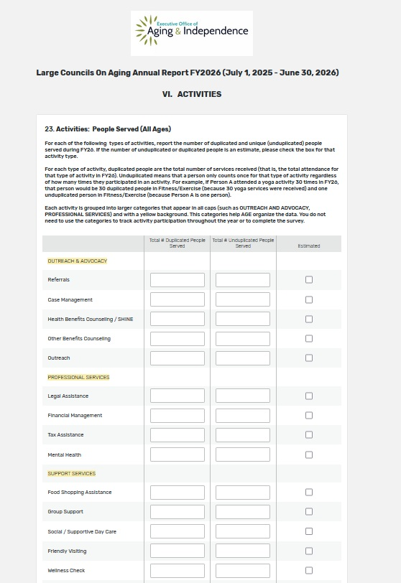
Page 8 – Activities
Duplicated = # people*attendance
Unduplicated = unique participants (count only once).
Refer to Categories and Definitions document to determine where to count activities.
No need to track umbrella categories.

Slide 12
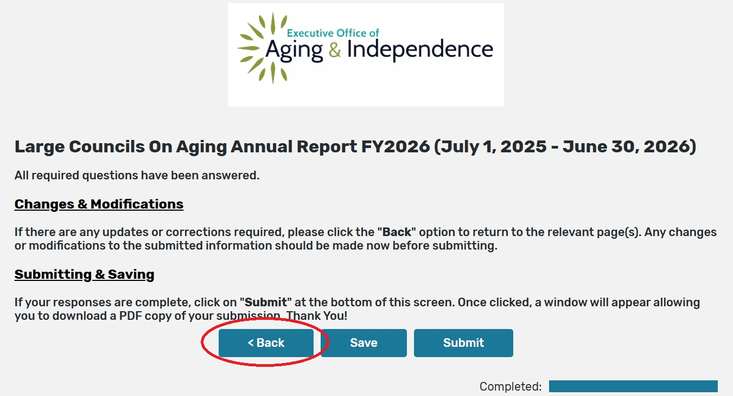
Page 9 – Submission
Use back button at bottom of page to make changes—NOT back button on browser.

Slide 13
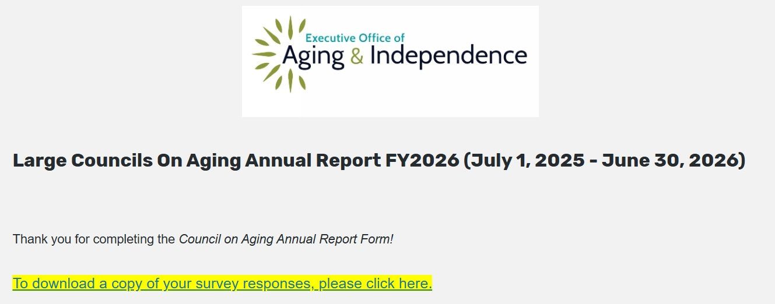
Page 10 - End
Questions?
adam.frank@mass.gov | (617) 767-1475

Slide 14
Thank you!

